Slide 1
Module-4: STRUCTURES AND UNION :
Structure: Nested structures, Pointer and Structures, Array of structures, Self referential structures
Dynamic memory allocation: Singly linked list, typedef
Union: Storage classes and Visibility.

Slide 2
User Defined Data Types:
The data types defined by the user themself are referred to as user-defined data types. These data types are derived from the existing datatypes.
There are 4 types of user-defined data types in C. They are
Structure
Union
Enum
Typedef

Slide 3
Diff between Array and Structure

Slide 4
1. Structure:
A structure in C is a user-defined data type that allows you to group different types of variables under a single name. Structures are particularly useful for organizing related data together, such as information about an entity like a student, employee, or product.
As we know, C doesn't have built-in object-oriented features like C++ but structures can be used to achieve encapsulation to some level.
Why Use Structures?
To group variables of different types as array can hold only Homogenous data.
To create a complex data type that is easy to manage and use.
To model real-world entities in a program.

Slide 5
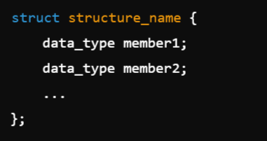
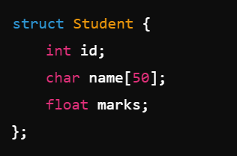
Defining a Structure
The struct keyword is used to define a structure.
Syntax:
Example:
structure_name: Name of the structure.
member1, member2, ...: Variables (members) of the structure.

Slide 6

Using Structures:
Declaring a Structure Variable: Once a structure is defined, you can declare variables of that type:

Slide 7
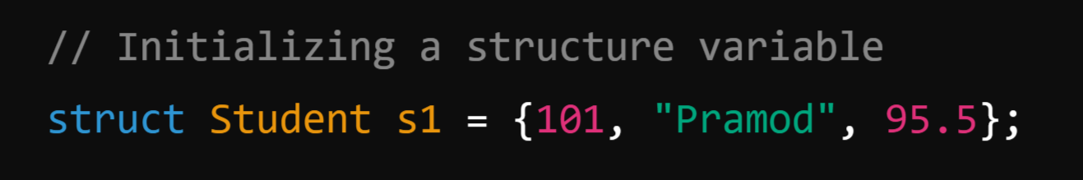
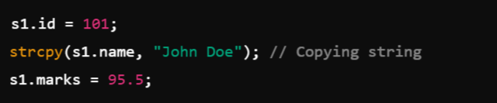
2. Initializing a Structure Variable: (Same way as we initialize Array)
OR

Slide 8
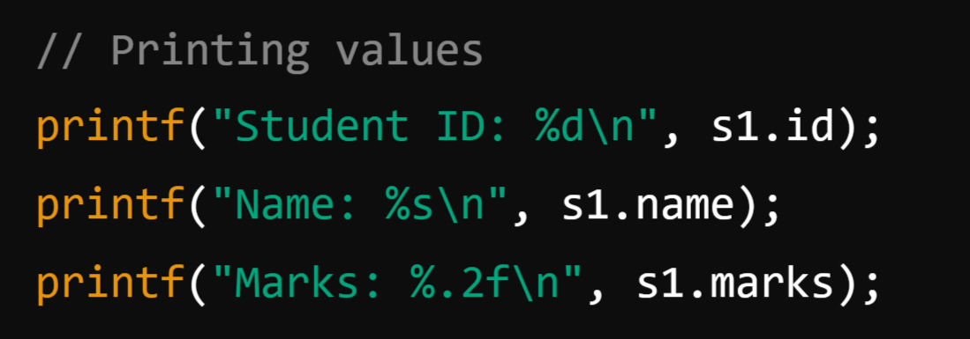
3. Accessing Members: Use the dot operator (.) to access structure members.

Slide 9
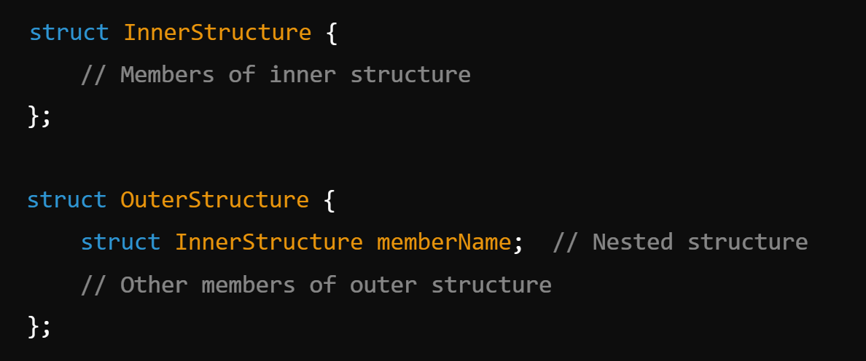
Nested Structures in C:
A nested structure in C is a structure that contains another structure as its member. It helps in creating complex data types by grouping related structures together.

Slide 10
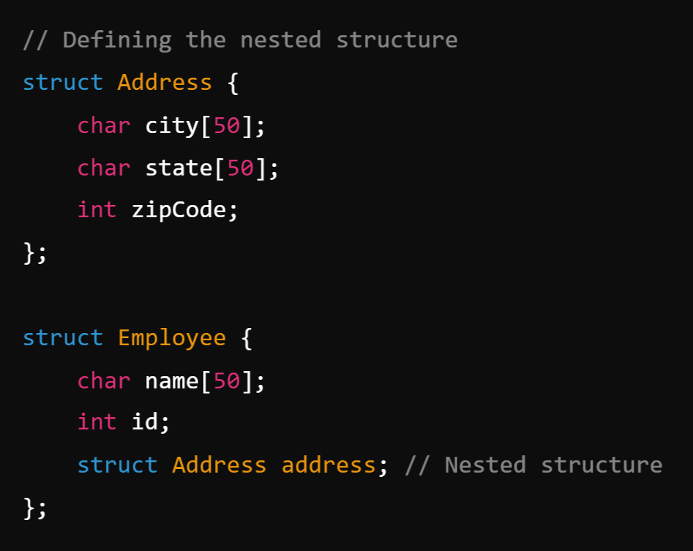
Example:
Storing Employee Details
with Address

Slide 11
Initializing the Nested Structure:

Slide 12
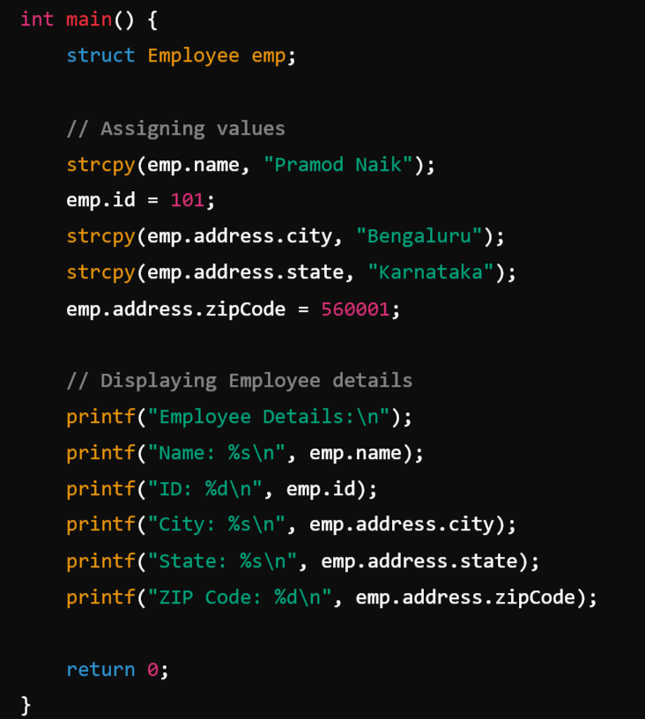
Explanation:
Define Inner Structure → struct Address contains city, state, and zipCode.
Define Outer Structure → struct Employee contains name, id, and struct Address address (nested structure).
Assign Values → Use strcpy() for strings and direct assignment for integers.
Access Nested Members → Use emp.address.city, emp.address.state, etc.

Slide 13
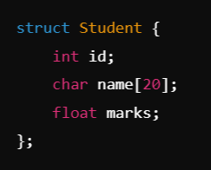
Pointer and Structures:
In C, pointers and structures can be used together to efficiently manage complex data structures. A pointer to a structure allows dynamic memory allocation, easier function parameter passing, and efficient data manipulation.
1. Declaring a Structure
A structure in C is a user-defined data type that groups related variables of different data types.

Slide 14
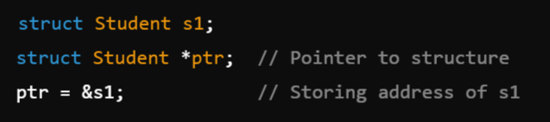
2. Declaring a Pointer to a Structure:
A pointer to a structure stores the address of a structure variable.

Slide 15
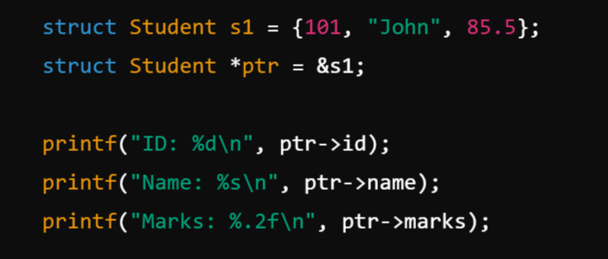
3. Accessing Structure Members Using a Pointer:
To access structure members using a pointer, we use the -> (arrow) operator.

Slide 16
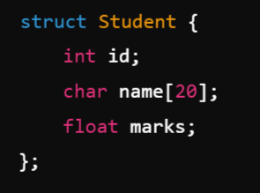
Array of structures:
An array of structures is a collection of multiple structure variables of the same type stored in contiguous memory locations. It helps in organizing related data efficiently.
1. Declaring an Array of Structures:

Slide 17

To create an array of structures:
Here, students is an array of 3 Student structures.

Slide 18
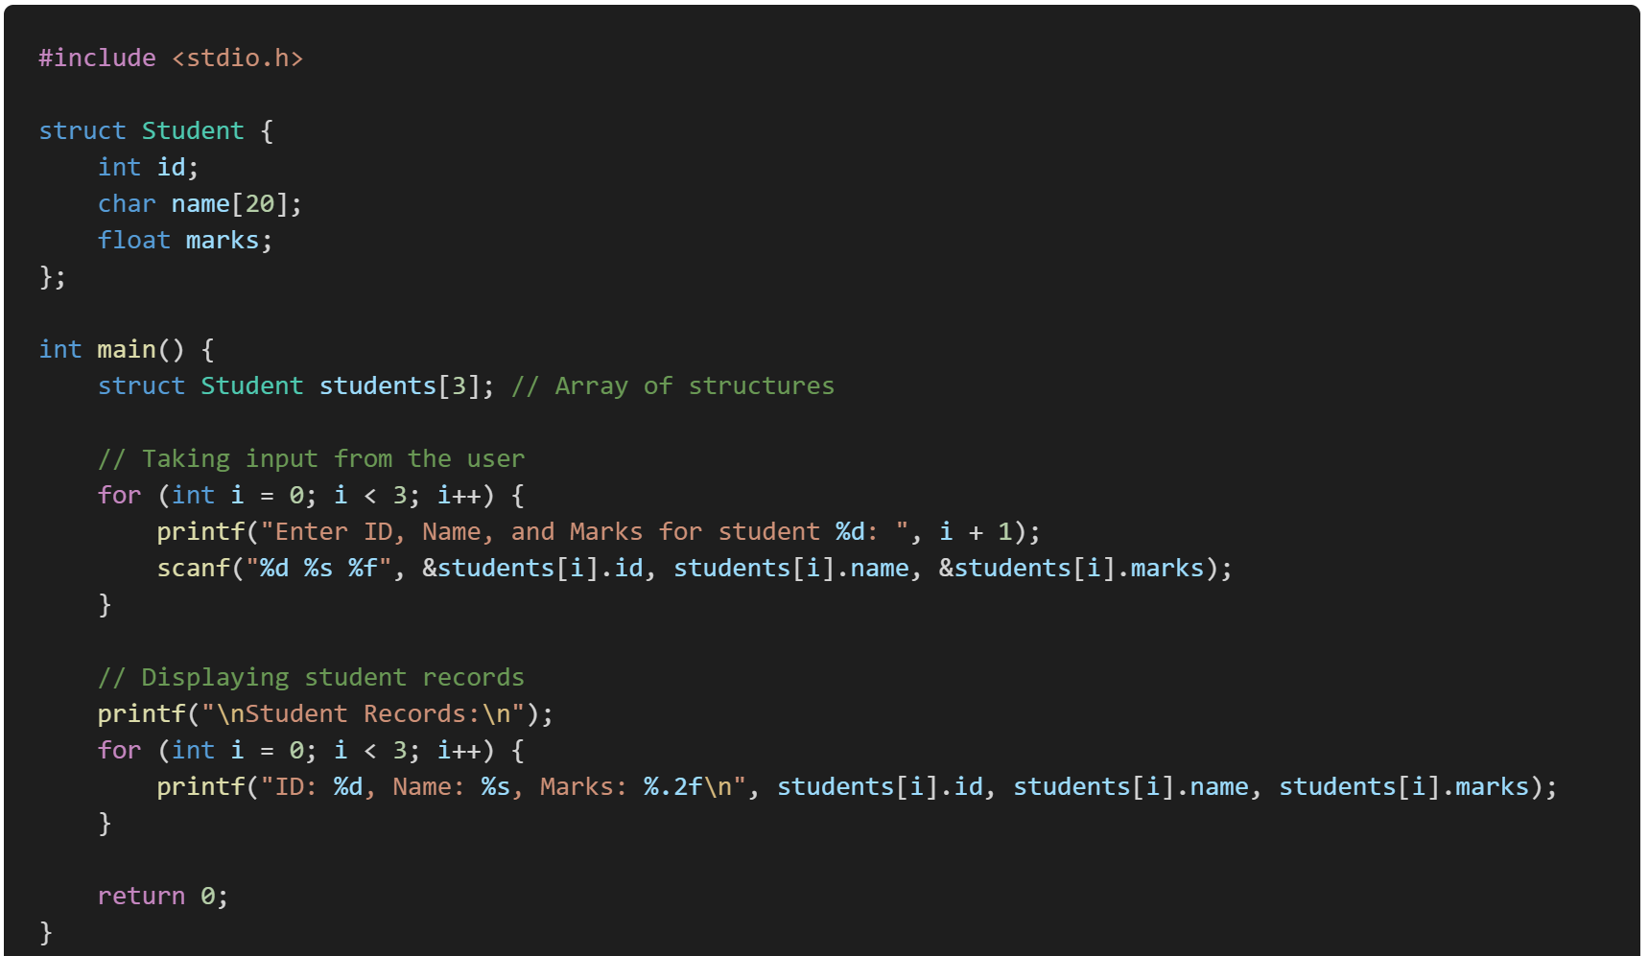
Example: Storing and Displaying Student Records

Slide 19
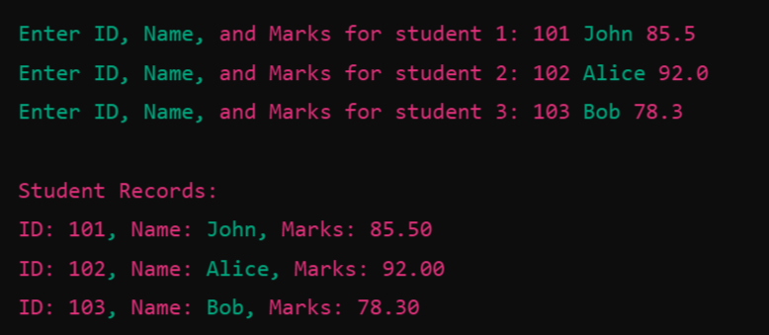
Input and Output:

Slide 20
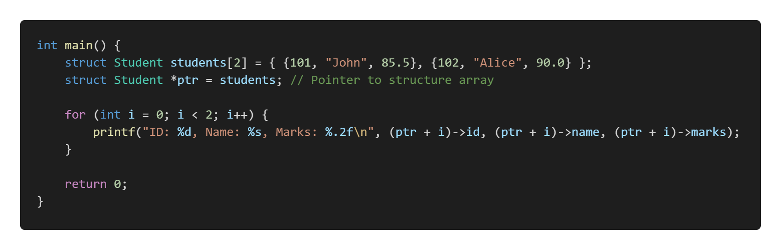
Accessing Structure Members Using a Pointer:
Instead of directly using an index, you can use a pointer to traverse the array.

Slide 21
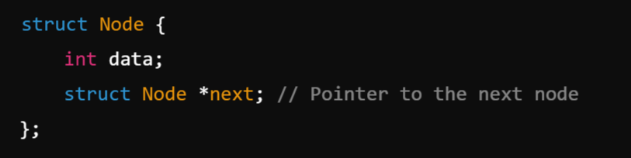
Self referential structures:
A self-referential structure is a structure that contains a pointer to an instance of itself. This is commonly used in data structures like linked lists, trees, and graphs.
Definition:
A self-referential structure typically includes a pointer that refers to another structure of the same type.
Example:
Here, struct Node contains an integer (data) and a pointer (next) that stores the address of another Node structure.

Slide 22
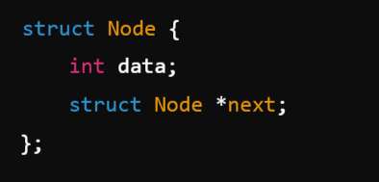
Types of Self-Referential Structures:
1. Linear Self-Referential Structures:
Each structure node has a pointer to the next node.
Example: Linked Lists

Slide 23
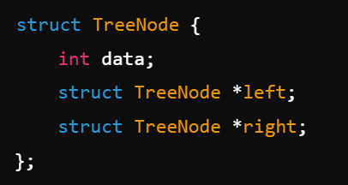
2. Non-Linear Self-Referential Structures:
A node contains multiple pointers.
Example: Binary Trees

Slide 24
Use Cases of Self-Referential Structures
Linked Lists (Single, Doubly, Circular)
Binary Trees & BSTs
Graphs
Stack & Queue Implementation

Slide 25
Dynamic Memory Allocation in C:
Dynamic memory allocation in C allows the program to allocate memory at runtime using pointers.
What is Dynamic Memory Allocation?
Dynamic memory allocation (DMA) is a process in C where memory is allocated at runtime using pointers. Unlike static memory allocation, which reserves a fixed amount of memory during compilation, dynamic memory allocation allows programs to request memory as needed while the program is running.

Slide 26
The C standard library provides four functions for dynamic memory management:
malloc() – Allocates a specified number of bytes but does not initialize them.
calloc() – Allocates memory and initializes all elements to zero.
realloc() – Resizes previously allocated memory.
free() – Frees allocated memory

Slide 27
Why Should We Use Dynamic Memory Allocation?
Efficient Memory Usage:
In static allocation, if you declare an array of size 100 but only use 10 elements, the remaining 90 elements remain unused, leading to wasted memory.
In dynamic allocation, you can allocate memory exactly as required.
2. Flexibility: If the size of data is unknown during compilation, dynamic allocation lets you adjust memory as needed at runtime.
3. Data Structure Implementation: DMA is essential for data structures like linked lists, trees, stacks, and queues, where elements are created and removed dynamically.
4. Avoid Stack Overflow: Large arrays or variables declared in functions consume stack memory, which is limited. Dynamic memory allocation utilizes the heap, which has a larger memory pool.
5. Memory Reallocation: With functions like realloc(), you can expand or shrink the memory as needed, avoiding unnecessary memory usage.

Slide 28

malloc() :
malloc() (Memory Allocation) is a standard library function in C that allocates a specified number of bytes in the heap memory and returns a void pointer to the allocated memory. The allocated memory contains garbage values (uninitialized).
Syntax of malloc():
size_t size: The number of bytes to allocate.
Returns: A void* pointer to the allocated memory or NULL if allocation fails.
The returned void* pointer should be typecast to the desired data type.

Slide 29
How to Use malloc()?
To use malloc(), follow these steps:
Declare a pointer of the required type.
Use malloc() to allocate memory.
Check if the memory allocation was successful (ptr != NULL).
Use the allocated memory as needed.
Free the memory using free() when done.

Slide 30
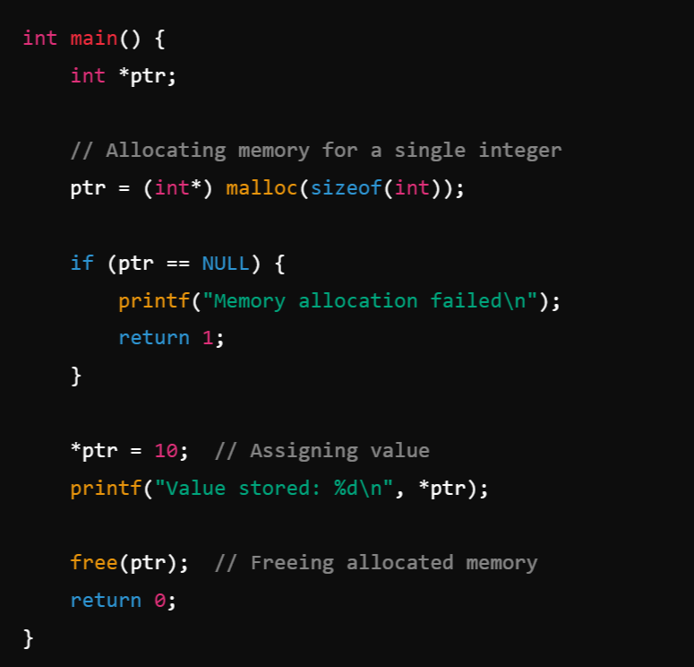
Example 1: Allocating Memory for an Integer

Slide 31
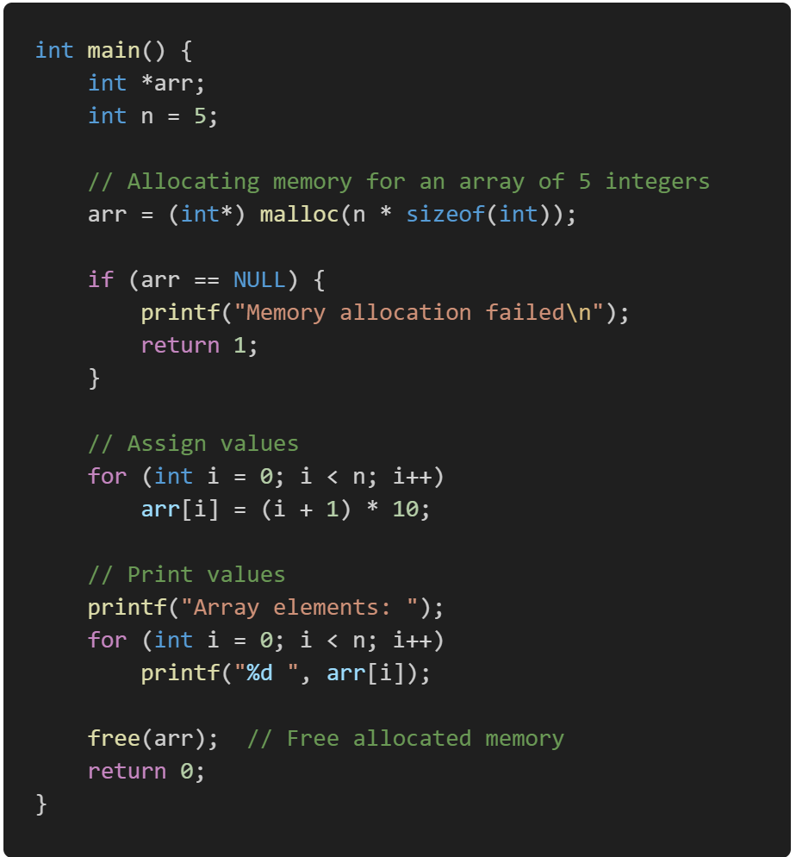
Example 2: Allocating Memory for an Array

Slide 32
Note:
Understanding arr[i] vs. * arr[i]:
arr[i] is equivalent to *(arr + i).
arr is a pointer to the first element of dynamically allocated memory.
arr[i] means "access the value at the address arr + i".
* arr[i] would imply that arr[i] is itself a pointer, which it is not in this case.

Slide 33
Key Points About malloc()
Returns void*, so typecasting is required (e.g., (int*) malloc(...)).
If allocation fails, malloc() returns NULL, so always check for NULL.
The allocated memory contains garbage values (use calloc() if you want zero-initialized memory).
Memory allocated with malloc() must be freed using free() to avoid memory leaks.

Slide 34

2. calloc():
The calloc() function in C is used for dynamic memory allocation. It allocates memory for an array of elements, initializes all bytes to zero, and returns a pointer to the allocated memory.
Syntax:
Where:
num → Number of elements to allocate.
size → Size of each element in bytes.
Returns → A pointer to the allocated memory block, or NULL if memory allocation fails.

Slide 35
Key Differences Between malloc() and calloc():
Feature | malloc() | calloc()
Initialization | Does not initialize memory | Initializes memory to zero
Parameters | Single argument (total bytes) | Two arguments (num & size)
Performance | Slightly faster since it doesn’t initialize memory. | Slightly slower due to zero initialization.
Memory Usage | May lead to uninitialized memory issues if not manually set. | Safer as memory is pre-initialized to zero.
Use Case | Preferred when initialization isn’t required. | Preferred when zero-initialized memory is needed.

Slide 36
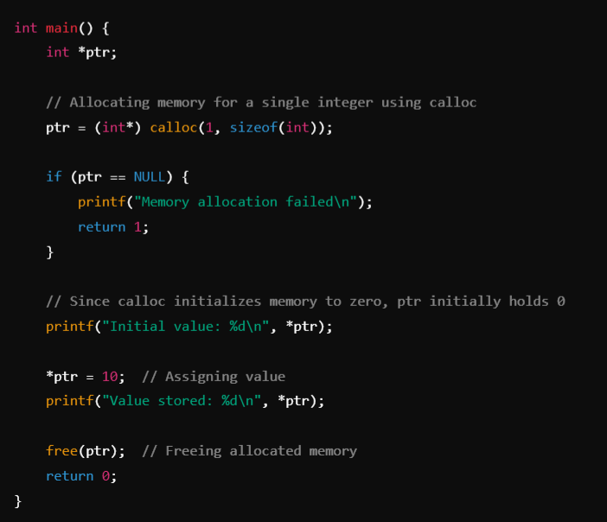
Example 1:
Allocating Memory for an Integer

Slide 37
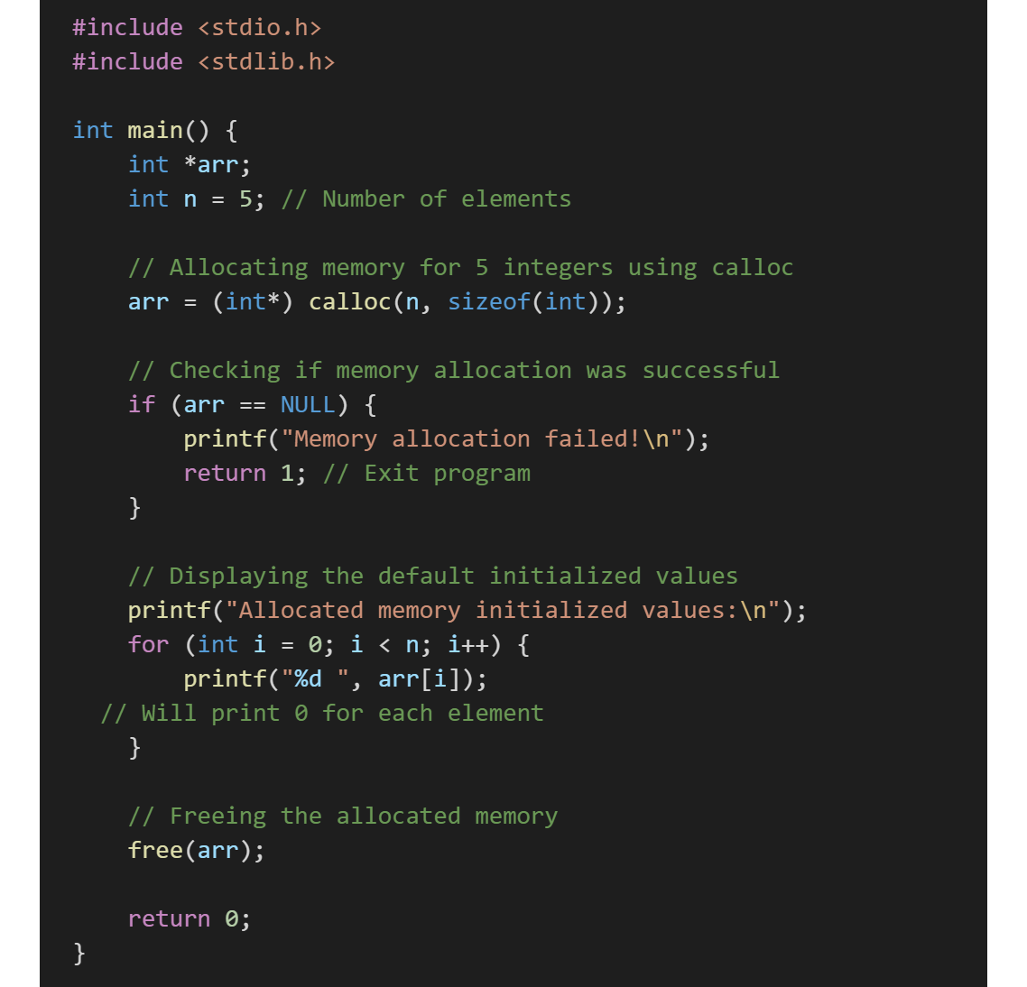

Exampl-2:
calloc(n, sizeof(int)) allocates memory for 5 integers.
The allocated memory is initialized to zero.
A NULL check is performed to handle allocation failure.
The values are printed (all should be 0).
free(arr) releases the allocated memory to prevent memory leaks.
Output:

Slide 38

3. realloc():
The realloc() function in C is used to resize a previously allocated memory block. It allows you to increase or decrease the memory size while preserving the existing data.
Syntax:
Where:
ptr → Pointer to the previously allocated memory block (malloc(), calloc(), or realloc()).
new_size → New size (in bytes) for the memory block.
Returns:
  A pointer to the newly allocated memory.
  NULL if reallocation fails (original memory remains unchanged).

Slide 39
How realloc() Works:
If ptr is NULL, realloc() behaves like malloc(), allocating a new memory block.
If new_size is 0, realloc() behaves like free(ptr), deallocating the memory.
If there is enough space adjacent to the current block, it is resized in-place.
If not, a new memory block is allocated, old data is copied, and the old block is freed.

Slide 40
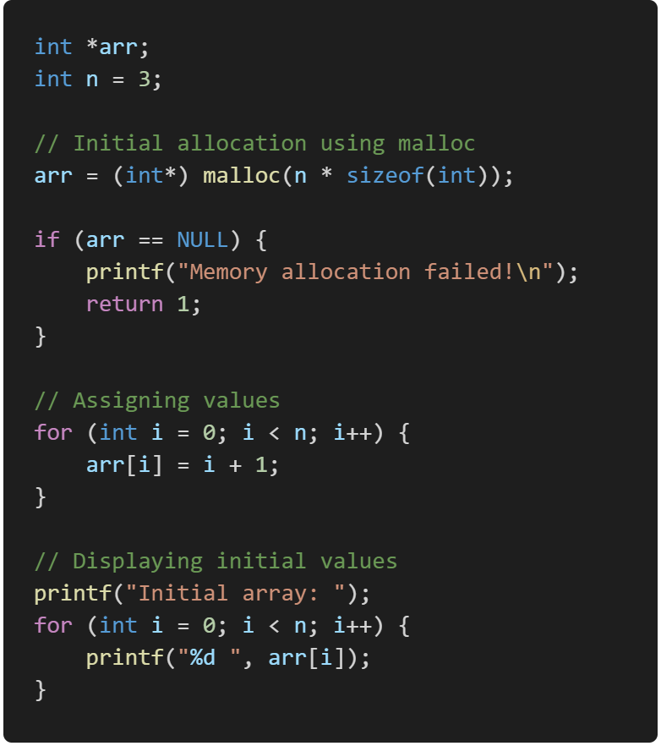
Example:
Step-1: Allocating a memory dynamically for 3 Elements.

Slide 41
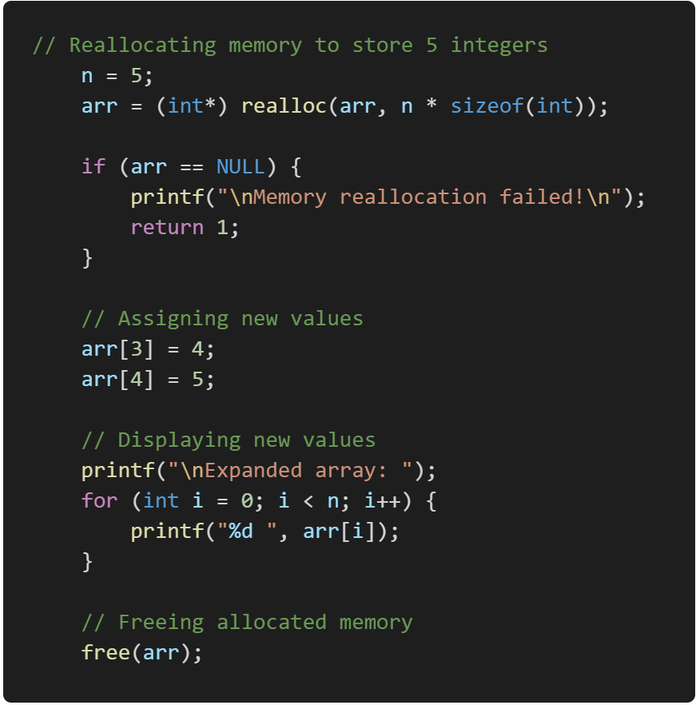
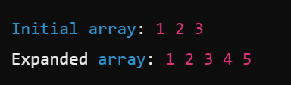
Step-2:
Re-Allocating the previously allocated memory by increasing the size by 3 to 5 Elements.
Output:

Slide 42
Key Points About realloc():
✔ If realloc() moves memory to a new location, the old data remains intact (not lost ) but copying takes time.
✔ If expansion happens in place, it's more efficient.
✔ Always check if realloc() returns NULL before using the new pointer.
✔ free(ptr) should always be used to release allocated memory.

Slide 43

4. free():
The free() function is used to deallocate dynamically allocated memory in C. It frees up the memory that was previously allocated using malloc(), calloc(), or realloc(), making it available for future use.
Syntax:
Where:
ptr is a pointer to the dynamically allocated memory that needs to be freed.

Slide 44
Key Points About free()
✔ Prevents memory leaks by releasing allocated memory when it's no longer needed.
✔ After calling free(ptr), the pointer still exists but the memory it pointed to is returned to the system.
✔ It is a good practice to set the pointer to NULL after freeing to avoid dangling pointers.
✔ Calling free() on a NULL pointer is safe and has no effect.

Slide 45
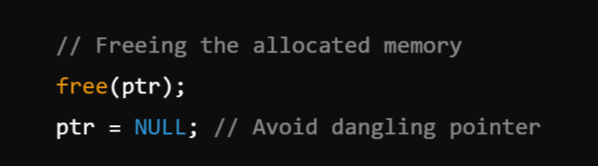
Example:

Slide 46

typedef:
The typedef keyword in C is used to create an alias (alternative name) for a data type, making the code more readable and easier to maintain.
Syntax:
existing_datatype → The original data type.
new_alias → The new name (alias) for the data type.

Slide 47
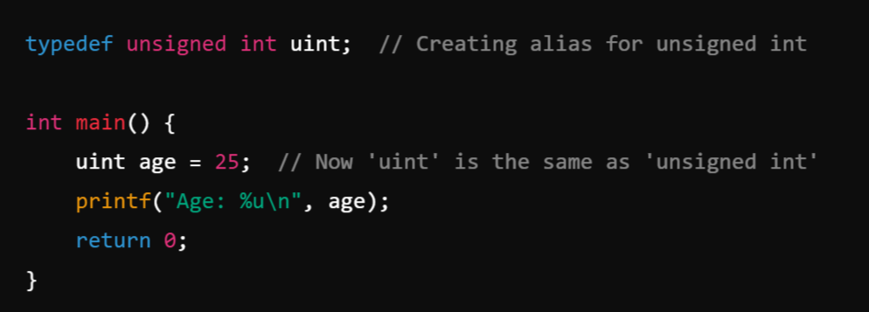
1. typedef with Basic Data Types
We can use typedef to create aliases for standard data types like int, float, etc.
Example:

Slide 48
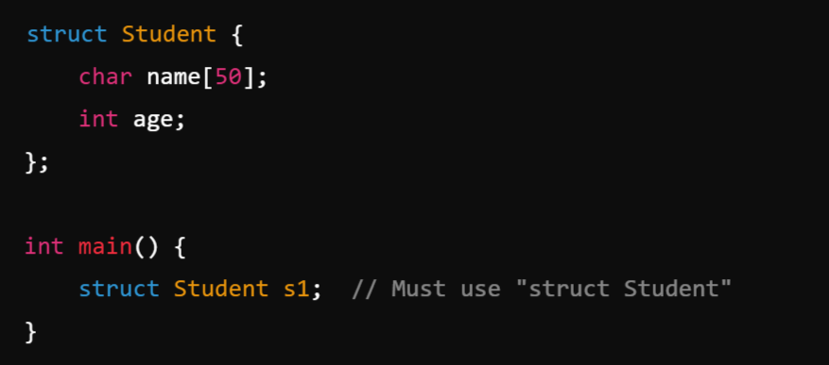
2. typedef with struct:
When defining struct, we normally have to use the struct keyword every time. typedef simplifies this.
Without typedef:

Slide 49
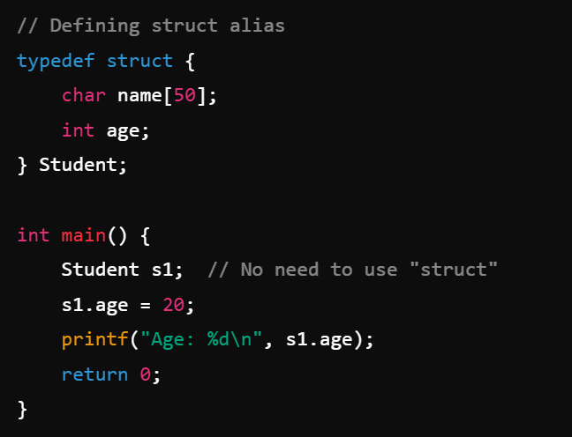
With typedef:

Slide 50
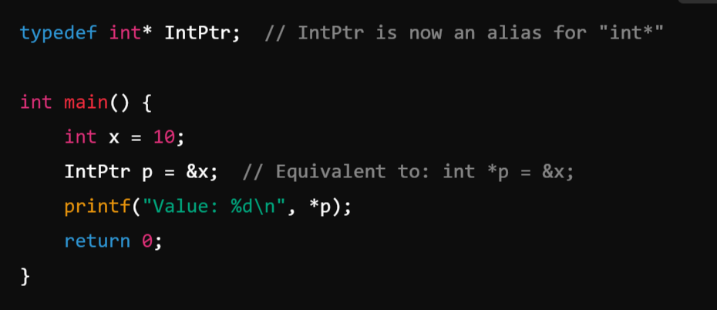
3. typedef with Pointers

Slide 51
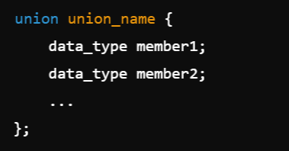
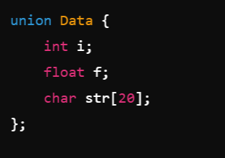
Union:
A union in C is a user-defined data type similar to a structure, but with a key difference: all members of a union share the same memory space. This means that a union can store only one value at a time for all its members. The size of a union is determined by the size of its largest member.
Unions are useful when you want to store different types of data in the same memory location, but only one piece of data is active at a time.
Syntax: Example:

Slide 52
Features of Union:
Shared Memory: All members share the same memory location.
Overwriting: Writing to one member overwrites the values of all other members.
  When you write to one member of a union, the previous values of all other members are lost because all members of the union share the same memory location. Writing a new value overwrites the shared memory, making the previous values of other members inaccessible or unpredictable.
Unpredictable Results: Accessing a member after another member has been modified results in garbage or undefined values.

Slide 53
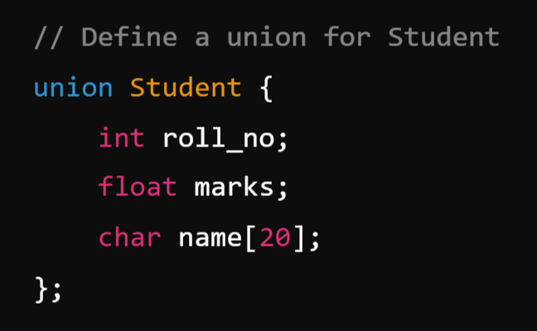
Example: Union for Student

Slide 54
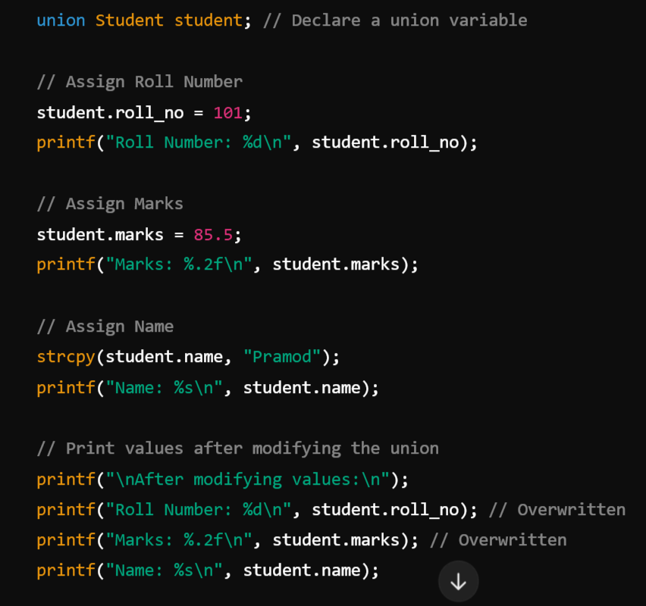
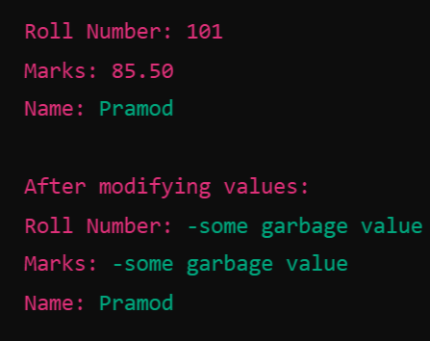

Output:

Slide 55
Explanation
Only one member can store data at a time because all members share the same memory.
Initially, we set roll_no = 101, but when marks = 85.5 is assigned, roll_no gets overwritten.
When we copy the string "Pramod" to name, the previous values (roll_no and marks) become invalid.
When to Use Union for Student?
If a student record requires either a roll number, marks, or name at a time, unions help save memory.
If you need to store all values simultaneously, a structure (struct) is a better choice.

Slide 56
Linked List in C:
A linked list is a linear data structure where elements (nodes) are stored in memory dynamically and linked using pointers. Unlike arrays, linked lists do not require contiguous memory locations and can grow or shrink dynamically.
Note:
A linked list uses non-contiguous memory allocation, unlike arrays, which store elements in contiguous memory locations. However, despite this, a linked list is still considered a linear data structure because of the way its elements are logically connected in a sequence.

Slide 57
Array and Linked List:
An array is a linear collection of data elements in which the elements are stored in consecutive memory locations. Its size is fixed.
A linked list, on the other hand, does not store its elements in consecutive memory locations, and the user can add any number of elements to it.
However, unlike an array, a linked list does not allow random access to data. Elements in a linked list can be accessed only in a sequential manner. But, unlike an array, insertions and deletions can be performed at any point in the list in constant time, provided that the reference to the node is already available.
A linked list can be visualized as a train or a sequence of nodes, where each node contains one or more data fields and a pointer to the next node.

Slide 58
Feature | Array | Linked List
Memory Allocation | Contiguous memory allocation | Non-contiguous memory allocation
Size | Fixed at declaration | Dynamic, grows or shrinks as needed
Element Access | Random access via index (O(1)) | Sequential access (O(n))
Insertion | Costly (O(n)), requires shifting | O(1) at head/tail, O(n) in middle
Deletion | Costly (O(n)), requires shifting | O(1) at head/tail, O(n) in middle
Memory Efficiency | Pre-allocated, can lead to wastage | No wastage, but extra memory for pointers
Cache Friendliness | High (due to contiguous storage) | Low (scattered memory locations)
Data Storage | Stores only data | Stores data + pointer(s)
Traversal | Can be done in both forward and reverse easily | Forward in singly linked, both ways in doubly linked
Types | One-dimensional, Multi-dimensional | Singly, Doubly, Circular Linked Lists
Overhead | No extra space required | Extra memory needed for pointers
Best Use Case | When fast access and fixed size are needed | When frequent insertions/deletions are needed

Slide 59
Types of Linked Lists
Singly Linked List - Each node points to the next node.
Doubly Linked List - Each node has pointers to both the next and previous nodes.
Circular Linked List - The last node links back to the first node.

Slide 60
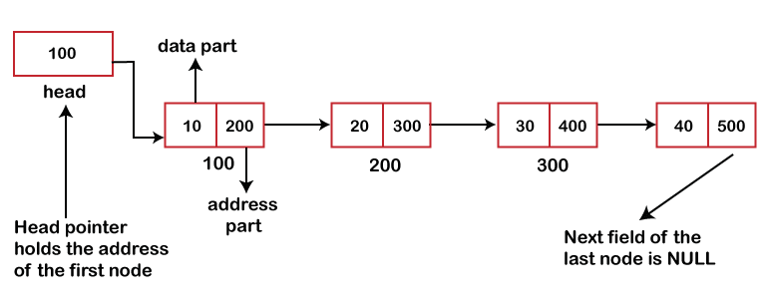
Singly Linked List
NULL

Slide 61
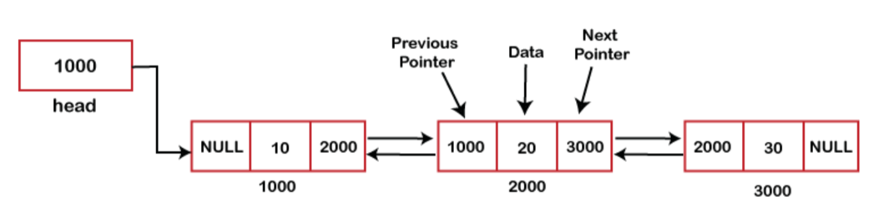
2. Doubly Linked List

Slide 62
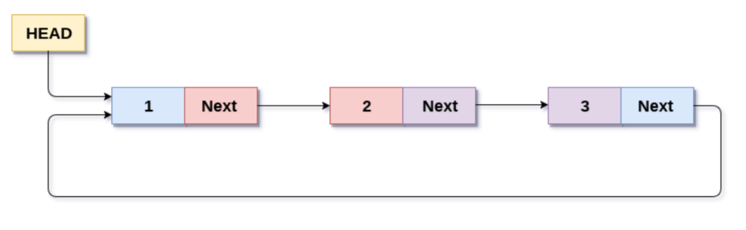
3. Circular Linked List

Slide 63
Singly Linked List:
A Singly Linked List is a type of linked list where each node has two parts:
Data (stores the actual value).
Pointer (next) (stores the address of the next node).
Unlike arrays, singly linked lists are dynamically allocated, allowing flexibility in adding or removing elements.
Since in a linked list, every node contains a pointer to another node which is of the same type, it is also called a self-referential data type.

Slide 64
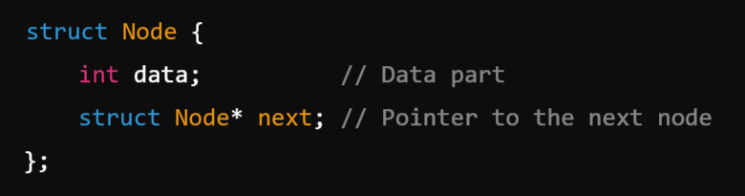
Structure of a Node in a Singly Linked List
In C, we define a node using struct:
The data field stores the value of the node.
The next pointer stores the address of the next node. (Self Referential Structure)

Slide 65
Example:
NULL

Slide 66

Operations in a Singly Linked List
Insertion
  At the beginning
  At the end
  At a specific position
Deletion
  At the beginning
  At the end
  A specific node
Traversal (Displaying the list)
Before Starting any Operation Create Head Pointer First as a Global Pointer.

Slide 67
  Insertion At the Beginning: A new node is inserted before the head node.
  Steps for Insertion at the Beginning in a Singly Linked List
  Step-1: Create a New Node
    Allocate memory for a new node.
    Assign the data to the new node.
  Step-2: Set the next Pointer of the New Node
    Make the next of the new node point to the current head node.
  Step-3: Update the Head Pointer
    Change the head pointer to point to the new node.

Slide 68
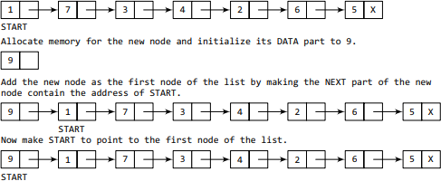
Example:

Slide 69
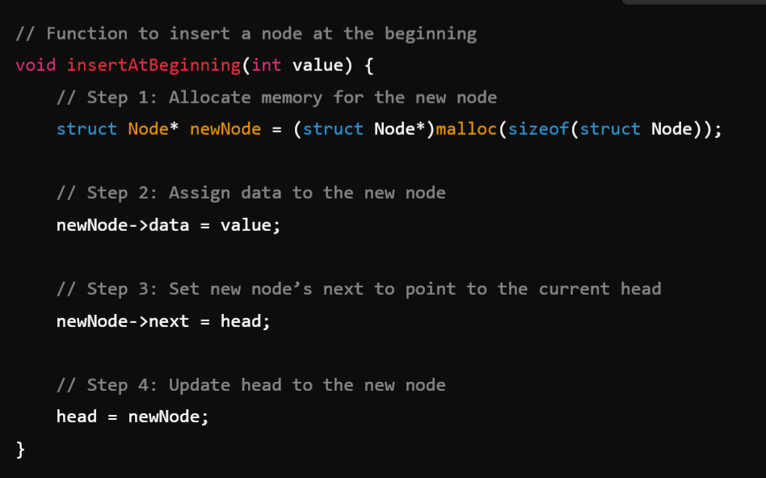
Program Example:

Slide 70
2. Insertion At the End:
Steps for Insertion at the End
Step-1: Create a new node
  Allocate memory for a new node using malloc().
  Assign the given value to the new node's data.
  Set the new node’s next pointer to NULL (since it will be the last node).
Step-2: Check if the list is empty
  If head == NULL, set head to the new node and return.
Step-3: Traverse to the last node
  Use a temporary pointer to iterate through the list until the last node is found (temp->next == NULL).
Step-4: Update the last node’s next pointer
  Set temp->next to the new node.

Slide 71
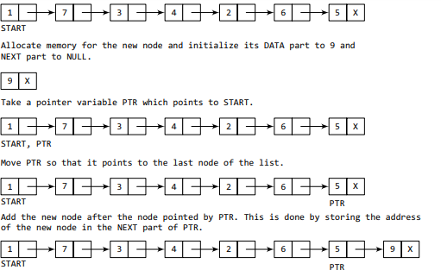
Example:

Slide 72
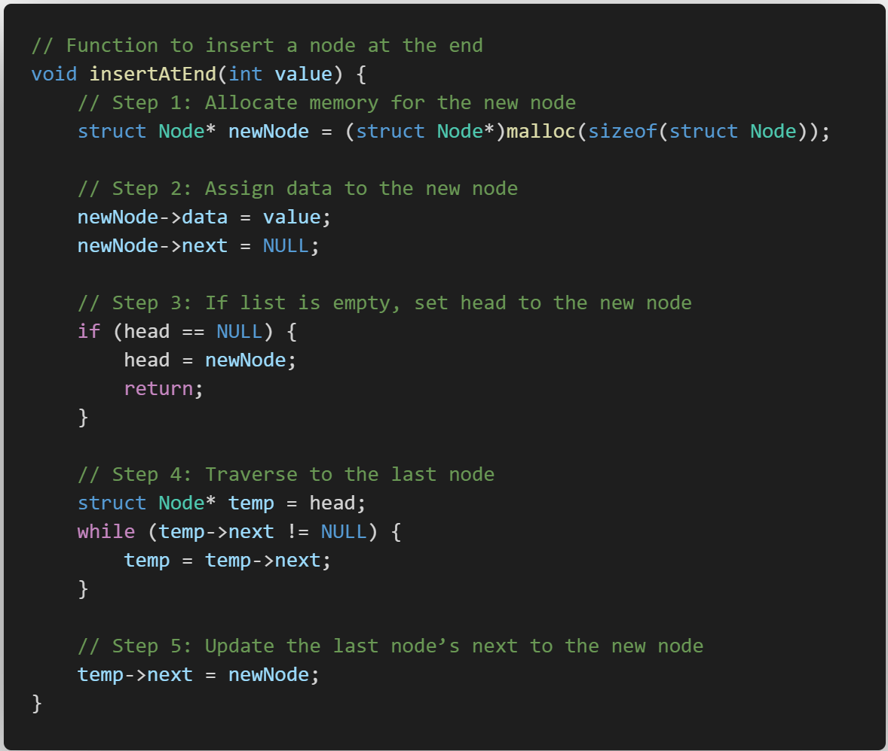
Program Example:

Slide 73
3. Insertion at a Specific Position (Middle): Inserting a node in the middle of a linked list means inserting it at a given position.
Steps for Insertion at a Specific Position
Step-1: Create a new node
  Allocate memory for a new node using malloc().
  Assign the given value to the new node's data.
Step-2: Handle Special Case (Position = 1 → Insert at Beginning)
  If the position is 1, use the insertion at the beginning method.
Step-3: Traverse to the (position - 1)th Node
  Use a temporary pointer to move to the node just before the desired position.
  Stop when the current position reaches (pos-1).
Step-4: Check for Invalid Position
  If the list is shorter than the required position, print an error message.
Step-5: Insert the New Node
  Set the next pointer of the new node to point to the current (pos)th node.
  Update the (pos-1)th node’s next to point to the new node.

Slide 74
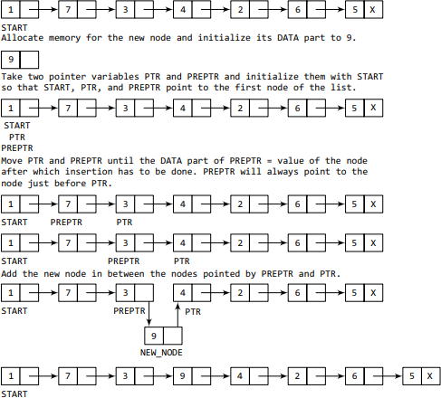
Example:

Slide 75
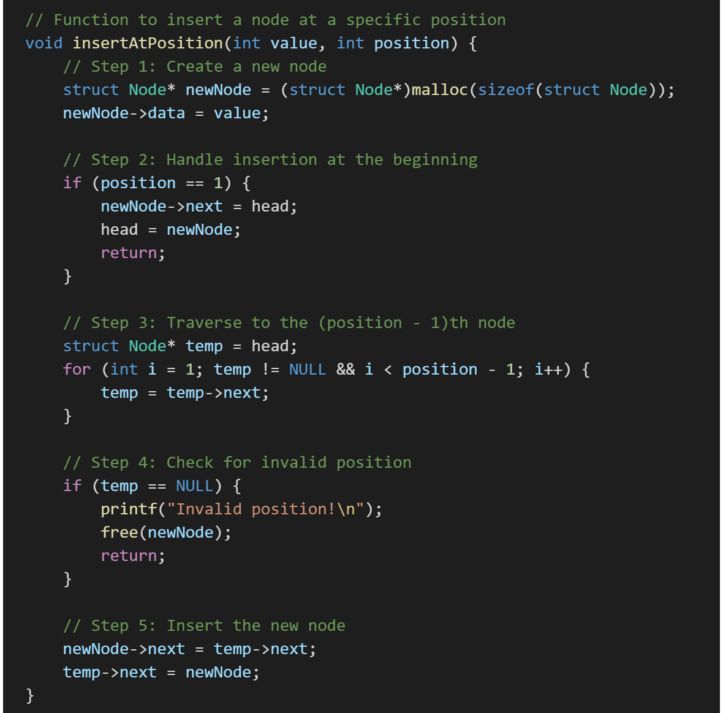
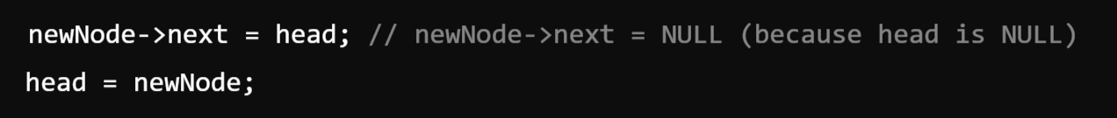
Program Example:

Slide 76
2. Deleting a Node

Slide 77
Deletion At the beginning:
Deleting a node from the beginning of a singly linked list means removing the head node and updating head to the next node.
Steps for Deletion at the Beginning
Step-1: Check if the list is empty
  If head == NULL, print an error message (no deletion possible).
Step-2: Store the current head node in a temporary pointer
  This will help in freeing memory after updating head.
Step-3: Update the head pointer
  Move head to the next node (head = head->next).
Step-4: Free memory of the deleted node
  Use free(temp) to deallocate memory and prevent memory leaks.

Slide 78

Example:

Slide 79
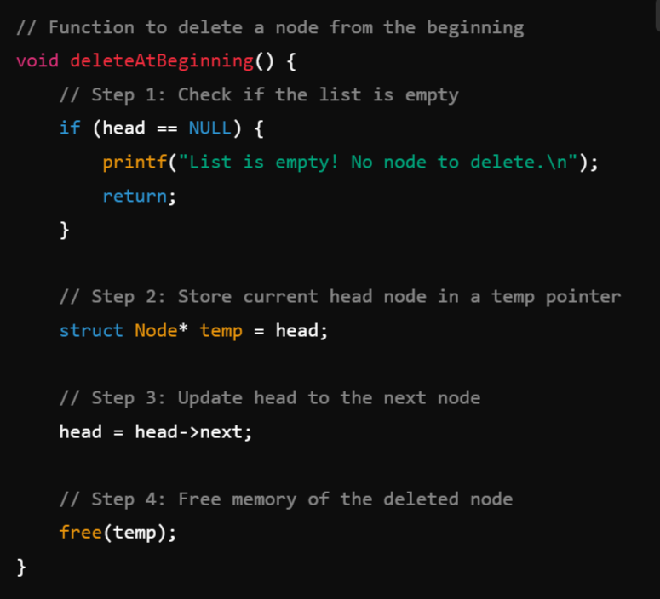
Program Example:

Slide 80
2. Deletion At the End:
Deleting a node from the end of a singly linked list means removing the last node and updating the second-last node's next pointer to NULL.
Steps for Deletion at the End
Step-1: Check if the list is empty
  If head == NULL, print an error message (no deletion possible).
Step-2: Check if there is only one node
  If head->next == NULL, free the head node and set head = NULL.
Step-3: Traverse to the second-last node
  Use a temporary pointer (temp) to iterate until temp->next->next == NULL.
Step-4: Free memory of the last node
  Store the last node in another pointer, free its memory, and set temp->next = NULL.

Slide 81
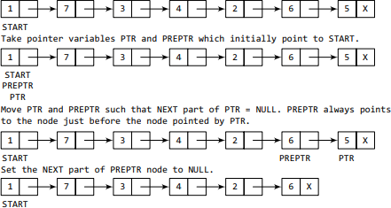
Example:

Slide 82
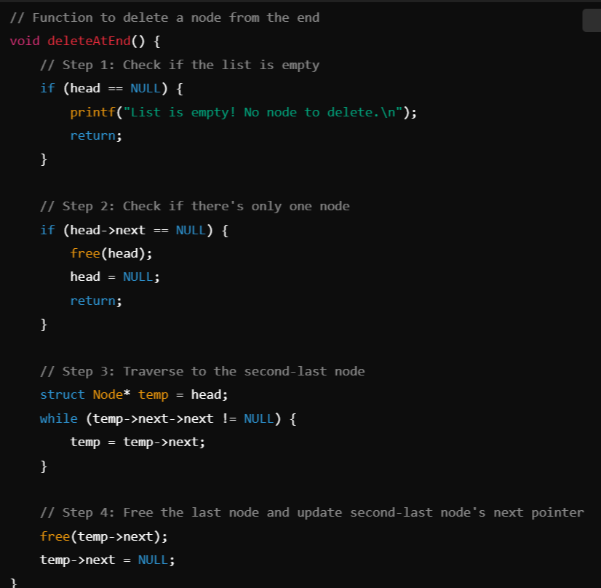
Program Example:

Slide 83
2. Deletion a Specific Node:
Steps for Deletion at a Specific Position
Step-1: Check if the list is empty
  If head == NULL, print an error message (no deletion possible).
Step-2: Check if the first node (head) needs to be deleted
  If position == 1, update head = head->next and free the old head.
Step-3: Find the node before the one to delete
  Traverse the list using a temporary pointer (temp).
  Stop at (position - 1)th node (the node before the one to be deleted).
Step-4: Check if the position is valid
  If temp == NULL or temp->next == NULL, print an error (position out of range).
Step-5: Delete the node
  Store the node to be deleted in another pointer, update temp->next = temp->next->next, and free memory.

Slide 84
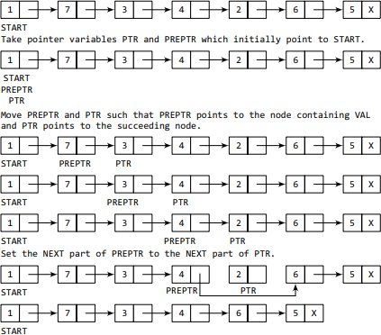
Example:

Slide 85

Program Example:

Slide 86
3. Traversal (Displaying the list):
Traversal in a singly linked list means visiting each node one by one and processing its data (e.g., printing it).
Steps for Traversal
Step-1: Check if the list is empty
  If head == NULL, print "List is empty!"
Step-2: Use a temporary pointer to traverse
  Start from head and move to next until NULL is reached.
Step-3: Print each node’s data
  Access temp->data and move temp = temp->next.

Slide 87

Example:

Slide 88
Advantages of Singly Linked List
✔ Dynamic Size → Can grow or shrink as needed.
✔ Efficient Insertions/Deletions → No need for shifting elements like arrays.
Disadvantages
❌ Sequential Access → No random access like arrays.
❌ Extra Memory Overhead → Each node requires additional memory for the pointer.

Slide 89
Storage classes and Visibility:
In C, storage classes define the lifetime, scope, and visibility of variables.
They specify where a variable is stored, how long its value is retained, and how it can be accessed which help us to trace the existence of a particular variable during the runtime of a program.
In C, there are 4 primary storage classes:
Automatic (auto)
Register (register)
Static (static)
External (extern)
Note: Each storage class has different visibility (scope) and lifetime (how long the variable exists in memory).

Slide 90
1. Automatic Storage Class (auto)
Characteristics:
Default storage class for local variables.
The variable is created when the function is called and destroyed when the function exits.
Stored in: Stack memory.
Scope: Block (local to the function where it is declared).
Lifetime: Limited to the function execution.
Default value: Garbage (uninitialized value).

Slide 91


Example:
auto is optional; writing int x = 10; is the same as auto int x = 10;.

Slide 92
2. Register Storage Class (register)
Characteristics:
Used for fast access variables, often stored in CPU registers instead of RAM.
Faster access than normal local variables.
Scope: Local to the function/block.
Lifetime: Limited to function execution.
No memory address (& operator cannot be used).
Default value: Garbage.

Slide 93

Example:
🔹 Note: If there are no free registers, the compiler will store the variable in RAM.

Slide 94
3. Static Storage Class (static)
Characteristics:
Retains its value even after function exits.
Scope: Local to function (if declared inside function), global (if outside any function).
Lifetime: Entire program execution.
Stored in: Data segment of memory.
Default value: 0 (if uninitialized).

Slide 95

Example: (Static in a Function):
🔹 Unlike auto, static variables retain their values across multiple function calls.

Slide 96
4. External Storage Class (extern)
Characteristics:
Used to share variables between multiple files.
Scope: Global (accessible across multiple files).
Lifetime: Entire program execution.
Stored in: Data segment.
Default value: 0 (if uninitialized).

Slide 97

Example (extern Variable in Multiple Files):
File 1 (main.c):
extern int x; → This declares x without defining it. It tells the compiler that x is defined elsewhere.
When printf("Value of x: %d\n", x); is executed, it will fetch the value of x from another file.

Slide 98

File 2 (external.c):
🔹 extern is used to declare a global variable in another file without creating a new copy.
This file defines x and assigns it a value of 100.
Since x is a global variable, it is accessible in other files where it is declared using extern.

Slide 99
Comparison of Storage Classes:
Storage Class | Scope | Lifetime | Memory Location | Default Value | Visibility
auto | Local | Function execution | Stack | Garbage | Local
register | Local | Function execution | CPU register (if available) | Garbage | Local
static | Local (if inside function), Global (if outside function) | Entire program | Data segment | 0 | Local (if inside function), Global (if outside)
extern | Global | Entire program | Data segment | 0 | Global

Slide 100
Module-4: STRUCTURES AND UNION :
Structure: Nested structures, Pointer and Structures, Array of structures, Self referential structures
Dynamic memory allocation - Singly linked list - typedef - Union -Storage classes and Visibility.

